Slide 1
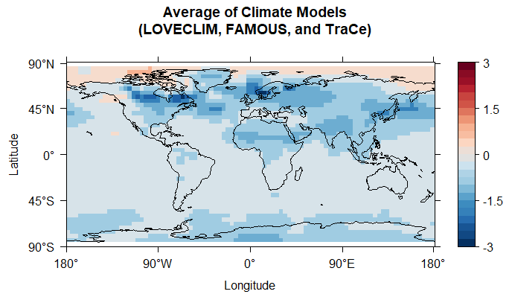
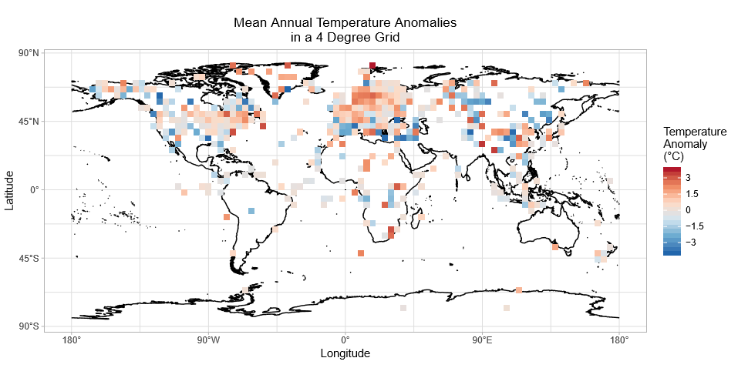
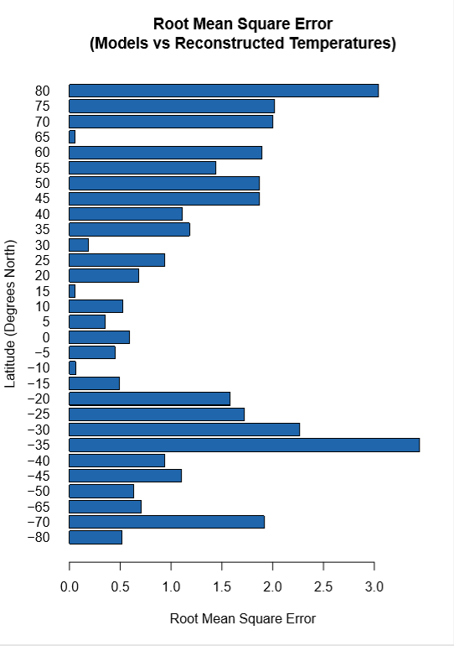
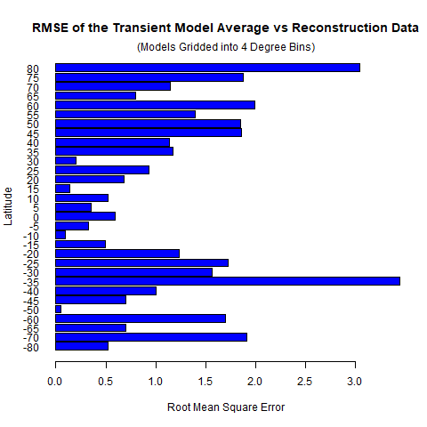
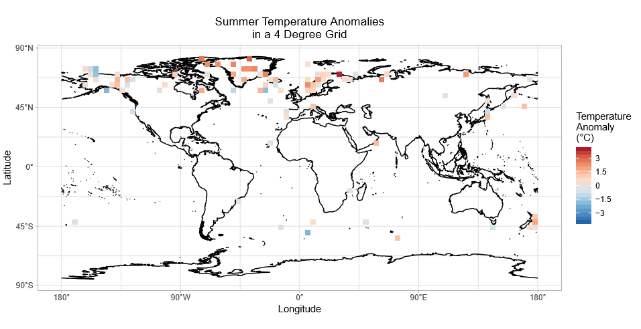

A Global Reconstruction of Temperatures 6,000 Years Ago
Sabrina A. Curtis
Climate Adaptation and Mitigation
Introduction
How well, and where, do climate models of temperature agree or disagree with proxy reconstructed temperature data from 6,000 years ago?
There is disagreement between modeled and reconstructed global temperatures throughout the Holocene (the last 12,000 years). Model simulations suggest temperatures were colder in the past, while reconstructions suggest they were warmer in the early to mid Holocene.
We constructed a Mid-Holocene (5,000-7,000 years ago) time slice of temperature anomalies in order to compare the models and data on a more spatially comprehensive and regional scale.
Changes in the Earth’s orbit caused strong solar radiation forcing at high latitudes; therefore, we predict the Arctic was warmer in the past. Past studies place the Holocene Thermal Maximum at 8 ka (8,000 years ago), so we also expect mean global temperature was slightly warmer at 6 ka than today.
My summer internship was located in Boulder, CO, at NOAA’s Earth System Research Laboratory. Dr. Carrie Morrill was my internship mentor. I chose this project because it makes use of my geology background and past experience analyzing data using the programing language R.
Procedure
Materials: A computer with the programming language R; proxy (e.g. ice cores, pollen, ocean sediments) based temperature reconstructions; climate models (LOVECLIM, FAMOUS, and TraCE)
Collect temperature reconstruction data
Have more continental sites because more data is available there
Variety in proxies/locations intended to diversify the data and reduce biases
Organize temperature data with its spatial and proxy information
Calculate mean temperatures at 6 ka based on spatial location
Calculate the temperature anomalies between 6 ka and present by averaging temperatures from the last 1,000 years (also spatially) and subtracting the results from corresponding 6 ka averages
Compare the reconstructed temperatures to the model outputs
Standardize spatial extent of modeled and reconstructed data
Average the transient climate models together (LOVECLIM, FAMOUS, TraCE)
Calculate the root mean square error.
Correct for the shape of the Earth
Average the temperatures into five degree latitude bands.
Calculate the error
Create maps to visualize results
Results
Proxy reconstructions indicate mean global temperature at 6 ka was 0.16ºC warmer than today
The models indicate it was -0.49ºC colder
Europe and Greenland appear warmer than today in the mean annual reconstruction map
Greenland’s warmer temperature trend is also present in the summer data; harder to tell with Europe
Models agree with the data regarding a warmer Arctic, but show a colder Greenland and Europe
Root Mean Square (RMS) Error
Lowest RMS error between 30º N and 15º S; best model-data match
Greatest disagreement at 80º N and 35º S
These regions have fewer data points; outliers can easily change the mean
Conclusions
The region from 15º S to 30º N has the best model-data agreement
The Arctic reconstructions and models show warmer temperatures 6,000 years ago than today, but disagree on the amount of warming. 75º N to 85º N is one of the areas with least model-data agreement.
Regions with high RMS errors are areas that likely need further analysis/data collection in order to resolve model-data discrepancy.
Analyzing more temperature reconstructions has not completely resolved the model-data discrepancy.
Figure 1 Map of the modeled annual temperature anomalies at 6 ka. The models were re-gridded into a four degree grid. Color is temperature anomaly (ºC)
Future Work
Include additional climate model outputs as they are expected to become available in the coming weeks/months.
Compare summer temperatures from the models to the reconstructed summer temperatures Some of the temperature reconstruction proxies are known to have a summer bias in their annual mean. Knowing this bias can exist, we will instead focus on reconstructed summer temperatures.
Figure 2 Map of the reconstructed mean annual temperature anomalies at 6 ka. Each square represents the average of data points within a four degree cell. Color is temperature anomaly (ºC)
Acknowledgements
I would like to thank my mentor Dr. Carrie Morrill for her guidance throughout the project, and for providing me with the model outputs as well as help collecting the temperature reconstruction data needed to make this project possible.
Funding was provided by the NOAA Hollings Scholarship Program.
Figure 4 Bar chart showing the root mean square errors for each 5 degree latitude band that contains reconstruction data. RMS error closer to zero means a closer model-data fit.
Figure 3 Map of the reconstructed summer temperature anomalies at 6 ka. Color is temperature anomaly (ºC)
National Oceanic and Atmospheric Administration | National Centers for Environmental Information
www.ncei.noaa.gov

